Slide 1









project on
WORLD WIDE ENERGY CONSUMPTION
Presented by Ankita Salunkhe

Slide 2

Introduction
This SQL-based project analyzes global energy data to explore the relationship between energy production, consumption, emissions, GDP, and population across countries. By using structured queries on a relational database, the project identifies key trends, country-wise comparisons, and per capita impacts. The insights help understand how energy usage reflects economic growth and environmental impact.

Slide 3

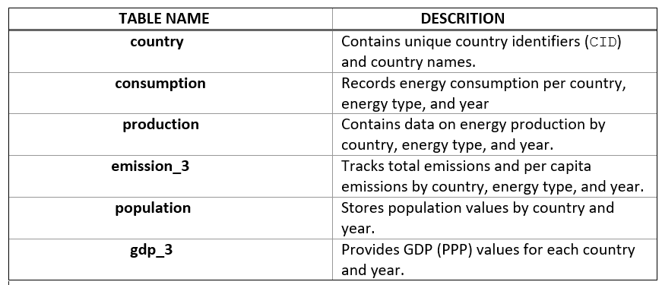
table description

Slide 4
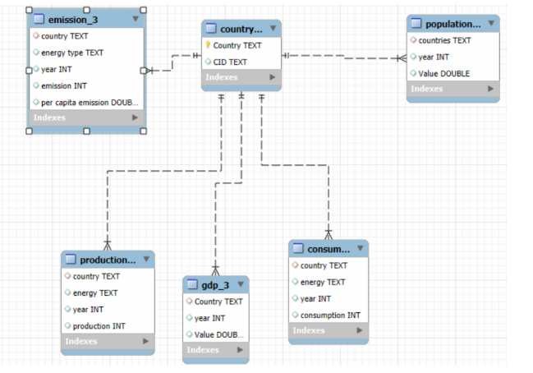
ER- Diagram

Slide 5
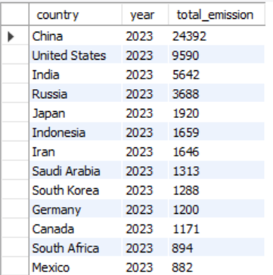
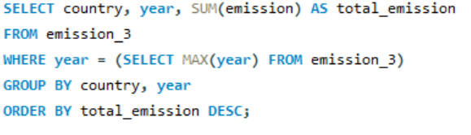
1. What is the total emission per country for the most recent year available?
The total emissions per country in the most recent year highlight the leading contributors to global pollution, with industrialized nations typically showing the highest values due to their energy-intensive economies.

Slide 6

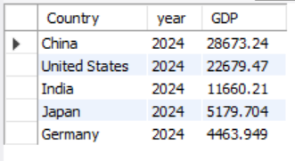
2. What are the top 5 countries by GDP in the most recent year?
The top 5 countries by GDP reflect the world’s largest economies, indicating their significant influence on global energy demand and emissions.

Slide 7
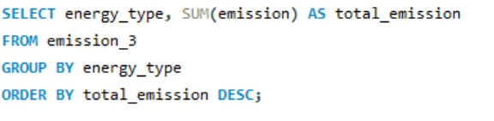
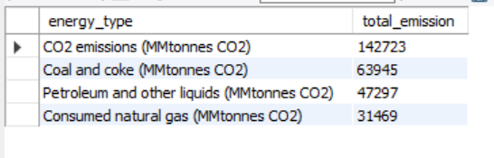
3. Which energy types contribute most to emissions across all countries?
Fossil fuels like coal, oil, and natural gas are the primary contributors to emissions across all countries, indicating a strong link between non-renewable energy use and environmental impact.

Slide 8
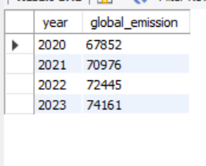
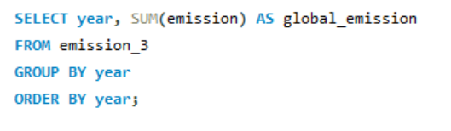
4. How have global emissions changed year over year?
Global emissions have shown a fluctuating yet generally increasing trend year over year, reflecting rising energy demand and industrial activity.

Slide 9


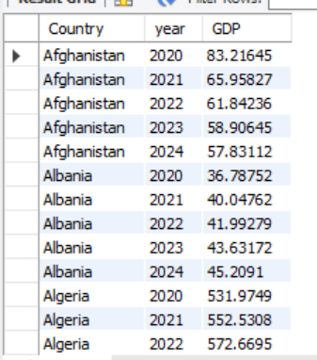

5. What is the trend in GDP for each country over the given years?
Most countries show a steady increase in GDP over the years, indicating consistent economic growth globally.

Slide 10
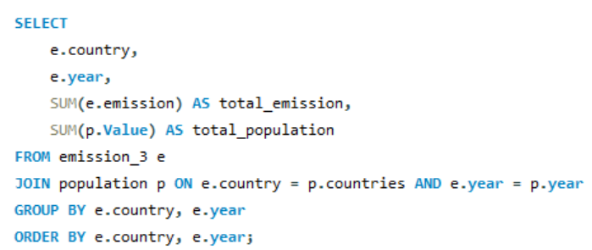
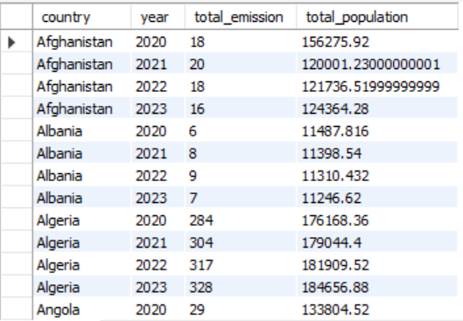
6. How has population growth affected total emissions in each country?
Population growth has generally led to higher total emissions, as increased population drives greater energy demand and consumption.

Slide 11

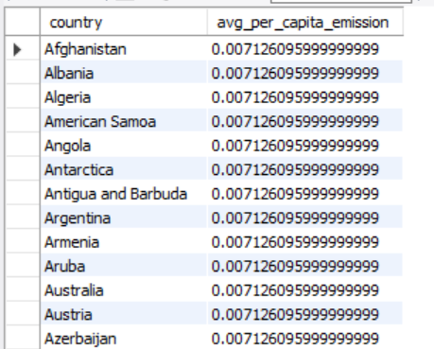

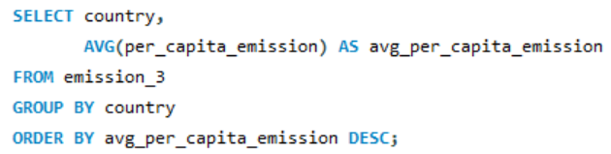
7. What is the average yearly change in emissions per capita for each country?
The average yearly change in emissions per capita varies by country, reflecting differences in development, energy policies, and industrialization levels.

Slide 12
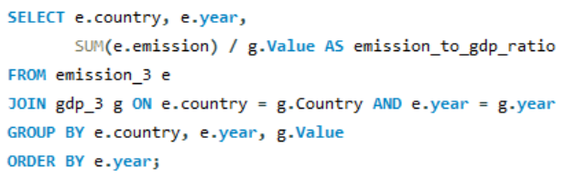
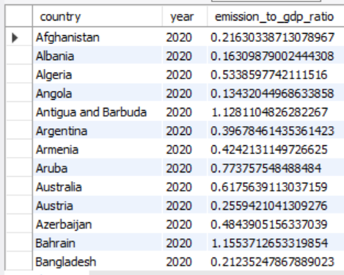
8. What is the emission-to-GDP ratio for each country by year?
The emission-to-GDP ratio reveals how efficiently countries generate economic output relative to their carbon emissions, highlighting disparities in environmental performance

Slide 13
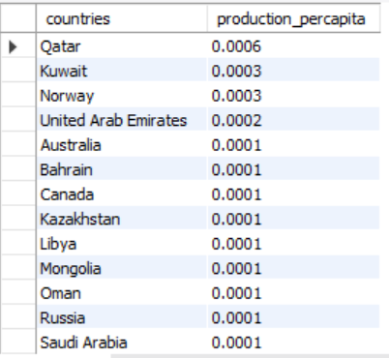
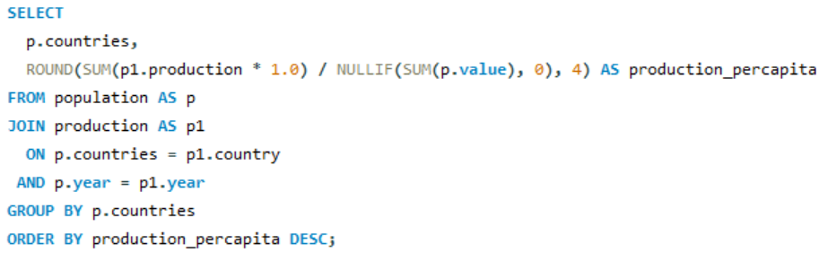
9. How does energy production per capita vary across countries?
Energy production per capita varies widely across countries, with resource-rich nations producing significantly more energy per person than others.

Slide 14
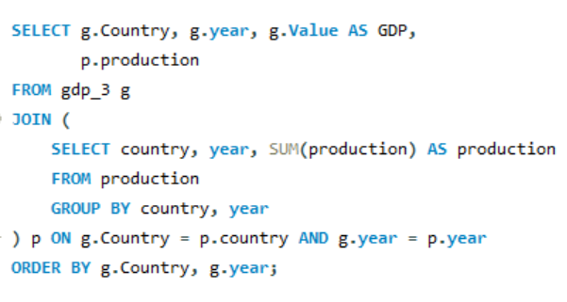
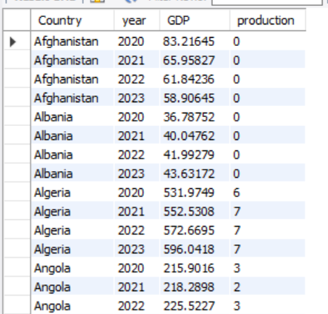
10. What is the correlation between GDP growth and energy production growth?
There is a strong positive correlation between GDP growth and energy production growth, indicating that economic expansion often drives increased energy generation.

Slide 15
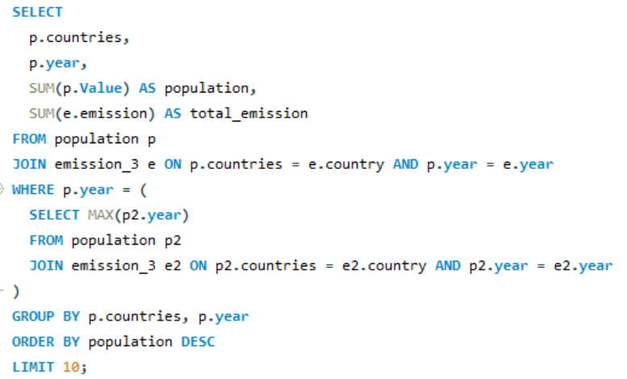
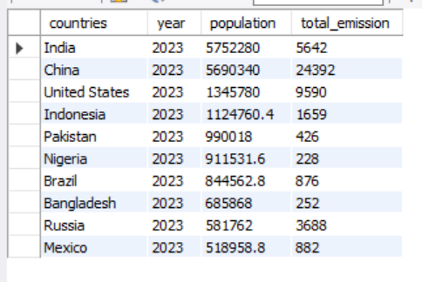
11 .What are the top 10 countries by population and how do their emissions compare?
The top 10 most populous countries contribute significantly to global emissions, though their individual emission levels vary based on industrialization and energy usage patterns.

Slide 16
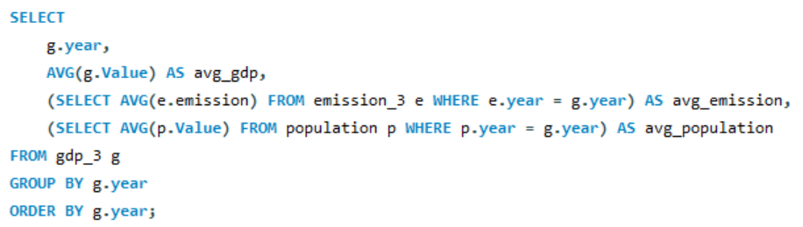
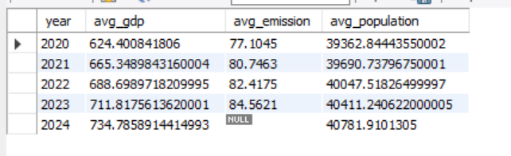
12. What is the global average GDP, emission, and population by year?
The global average GDP, emissions, and population have steadily increased year by year, reflecting worldwide economic growth, energy use, and population expansion.

Slide 17

Conclusion
This project provides a data-driven understanding of global energy patterns, revealing how energy consumption, production, GDP, and emissions are interrelated. By using SQL to analyze real-world datasets, we identified trends and country-wise differences that reflect economic development and environmental impact. These insights support informed decision-making for sustainable energy management.

Slide 18
Thank you!

